Slide 1
COPY ME Using facial expression

Slide 2
1)Team Name : DYNAMIC
-COPY ME is an Application that teaches facial expression to help Autistic Children.
-We designed two versions to help children get benefits from our model (Mobile Application, Desktop Application)
Each member's role:
Dina : Mobile Application
Esraa : Desktop Application
Nourhan : Model training

Slide 3
2)The Scenario:
Autistic Children have a problem in expressing their feelings in the correct way so our application helps them in training their face to make the right facial expression by recognizing their faces and comparing it with the photo they are trying to make after choosing it from the application
It’s important for Autistic Children to learn facial expression to be able to express their feelings right
Our goal is helping Autistic children to learn facial expression and express their feeling
Our target group is the autistic children’s parents and the organizations who is in charge of helping them

Slide 4
3)System Demo. Videos:
Desktop demo: https://drive.google.com/file/d/18dvJfqVDPZT9vfUn6X-5jjcPJqp6M9Tz/view?usp=sharing
Mobile demo: https://drive.google.com/file/d/1AAL5lhjaDvPid_hlhzIJio45a3bPOehj/view?usp=drivesdk

Slide 5
4)Description of the videos:
First : The user starts with choosing what photo he wants to make
Second : He opens his web cam (or mobile cam) and begins to make the expression
Third : The model will recognize his face and the expression he makes ,Then will compare the photo he chose with the expression he made and show his results
The features of the applications:
-It teaches autistic children facial expressions so they can express what they feel through their faces
-It allows children to learn emotions with instant feedback on their performance.
-Our app will work like a therapist that follows the development of the condition of autistic children

Slide 6
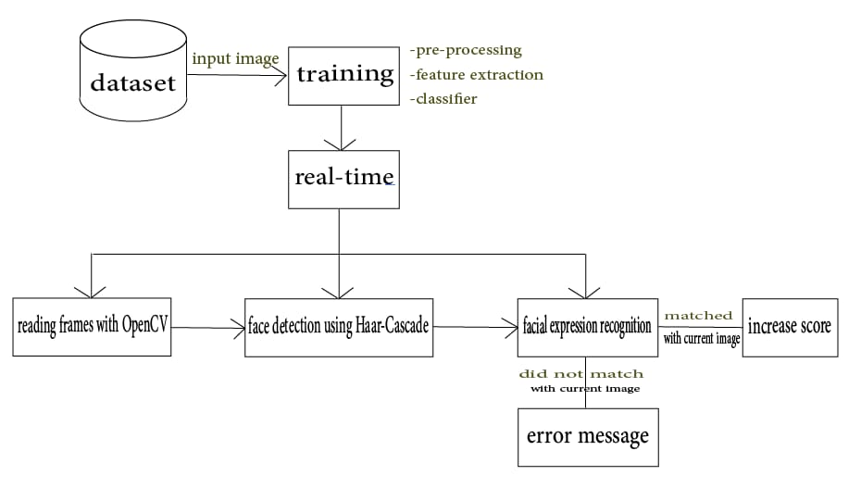
5)Technical architecture:
General Structure

Slide 7
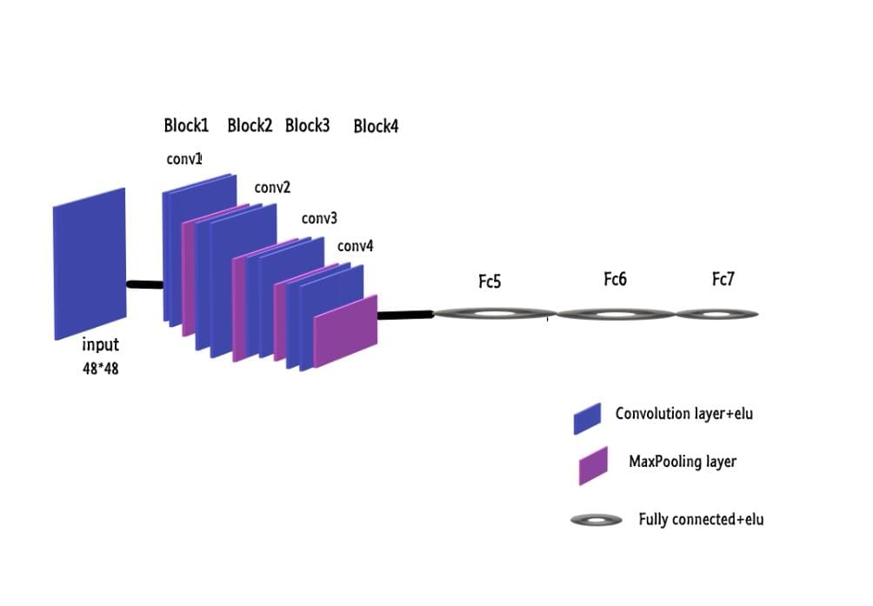
Dataset:
https://www.kaggle.com/msambare/fer2013
40000 images each image has a size 48*48
Machine Model :
We used VGG model with Keras using TensorFlow backend
Also used batch size 32 and epochs 25

Slide 8
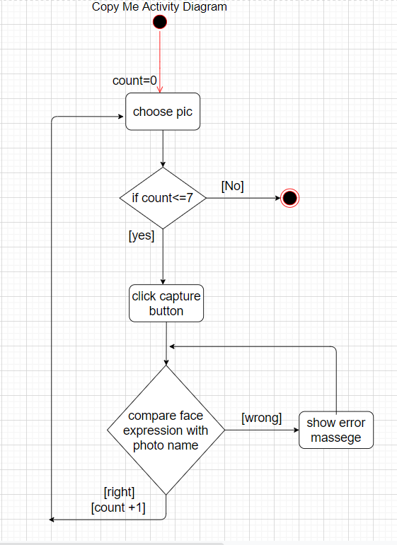
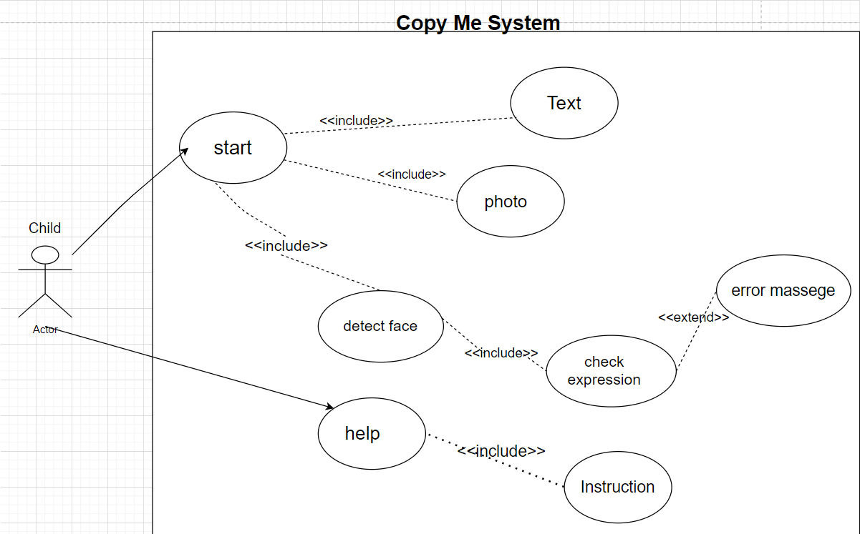
UML Diagrams:
Activity Diagram
Use Case Diagram

Slide 9
The Technologies:
We used:
web cam in the desktop application and mobile cam in the mobile application
We used Flutter in the mobile app and Tkinter in the desktop app
Tensorflow, pillow, numpy, keras libraries
Little VGG model to recognize facial expression

Slide 10
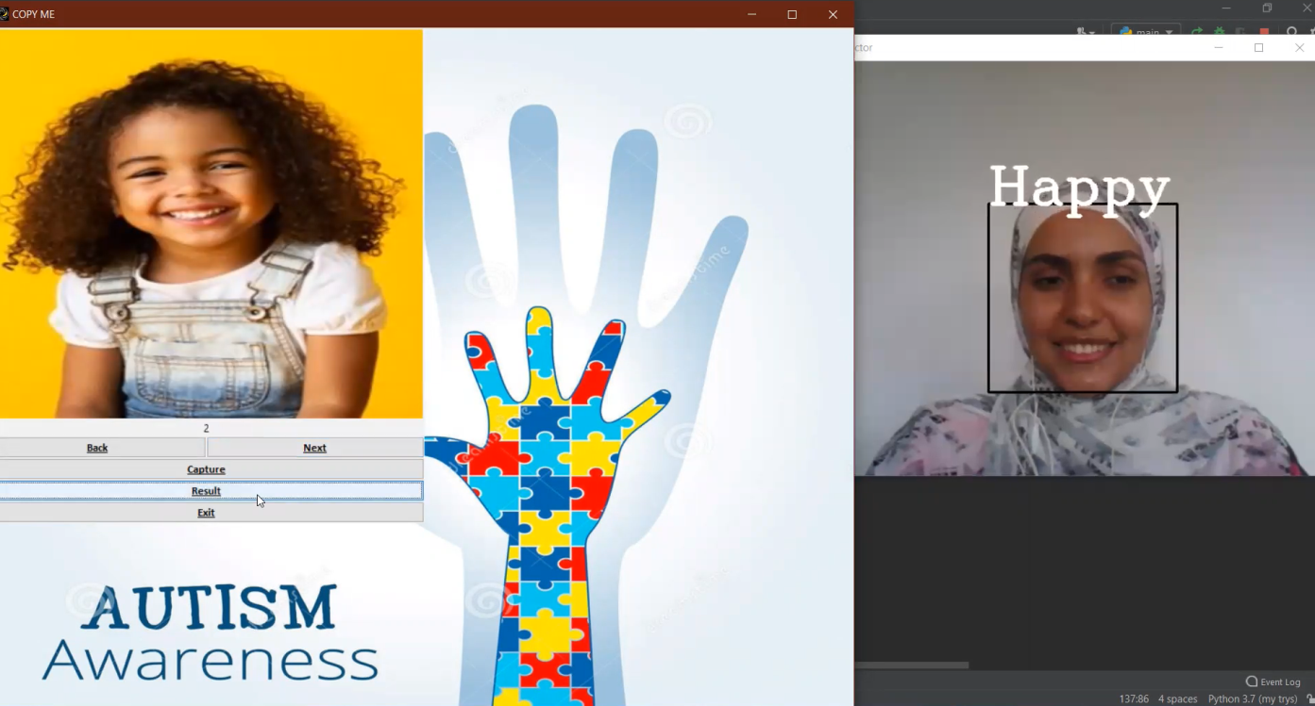
User Interface of Desktop Application:
The window after :
1-choosing a photo
2-clicking on (Capture) to turn on web cam and start capturing
3-clicking on (result) to get the user score

Slide 11
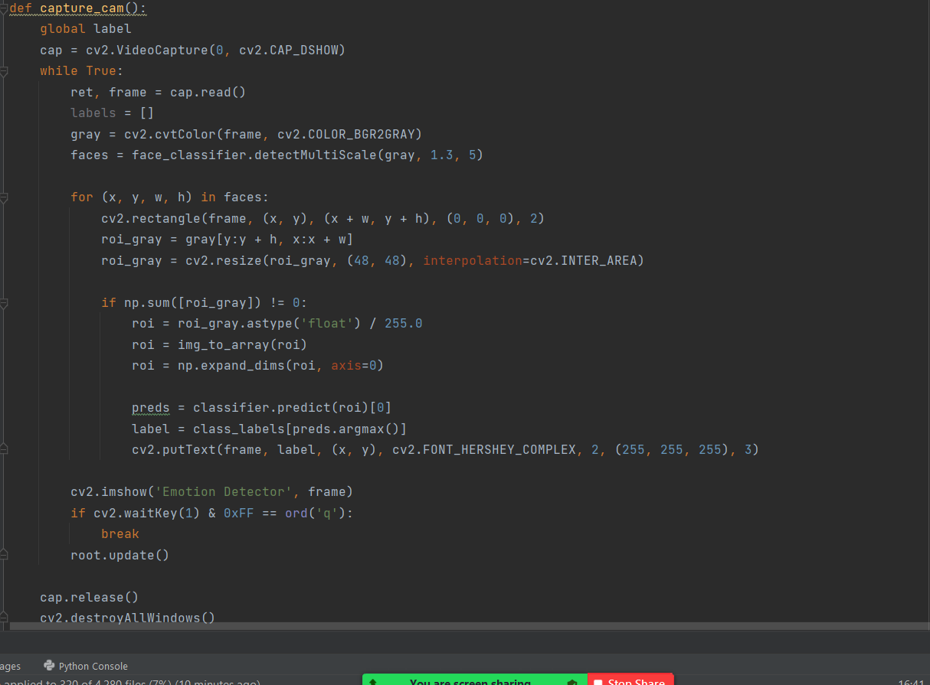
Example code for explanation:
In Desktop App:
1-In function ( capture_cam):The user will choose when to open his web cam to start capturing his facial expression and retriving (label) which refers to the expression he really make
After that the user click
the button (result) to call
the function (get_score)

Slide 12
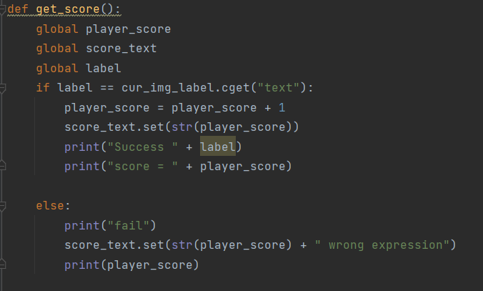
2- In function (get_score):
After clicking button(result), we comparing the “label” from model with “cur_img_label” name to see if the user made the right expression
-If (right) we increase the user score
-If(wrong) we show
an error message

Slide 13
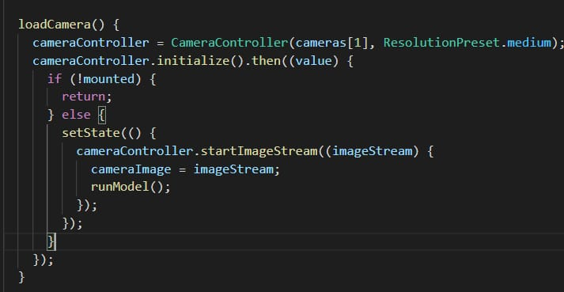
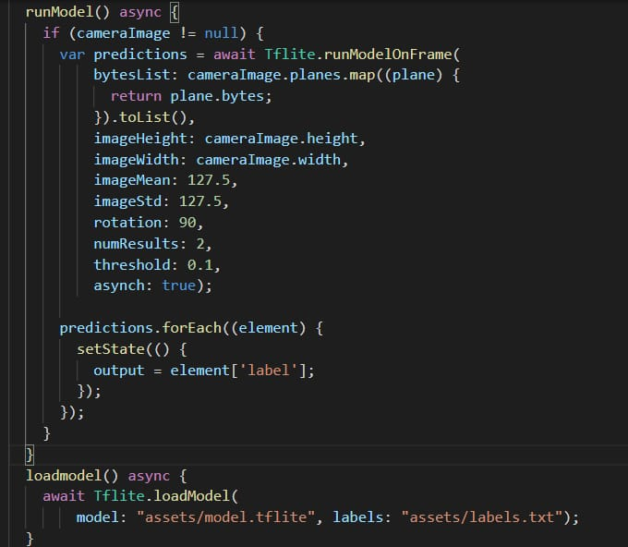
Mobile code explanation:
Most important functions
(Loadcamera) is for opening front mobile cam.
And calling (runModel) function

Slide 14
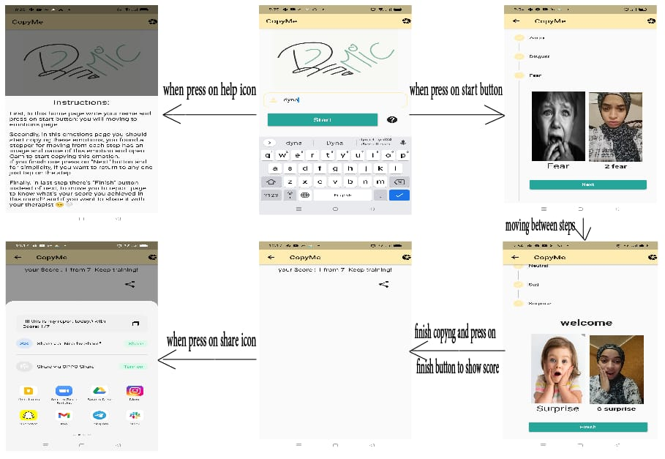
Wire Frame of Mobile Application:

Slide 15
6)Summary:
We are helping the Autistic children to recognize facial expression and be able to express them well
Future work:
We will make a database for each child record to let the therapist compare each child progress and let them know how to improve the child skills

Slide 16
References:
https://www.researchgate.net/publication/260480073_CopyMe_an_Emotional_Development_Game_for_Children
https://drive.google.com/folderview?id=1A8NkdJRZ6NCPg4dc01Kuzl_jkazOx8gc

Slide 17
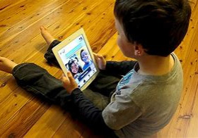
Simulation of Autistic child amused by using Copy Me App

